Slide 1
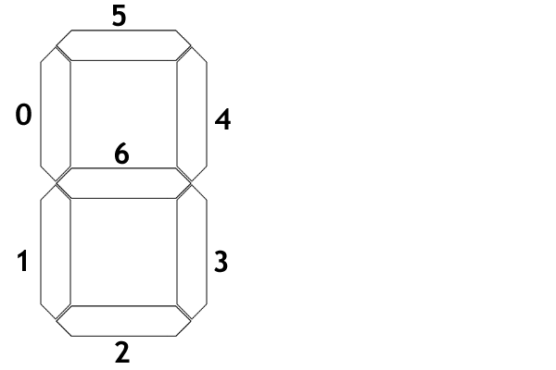
7-segment display logic synthesis
Codifica BCD dell’ingresso
x₃x₂x₁x₀
y
0 | 0000
1 | 0001
2 | 0010
3 | 0011
4 | 0100
5 | 0101
6 | 0110
7 | 0111
8 | 1000
9 | 1001
y
y
y
y
y
y

Slide 2
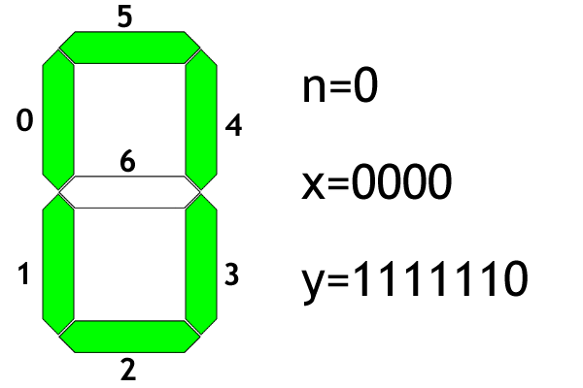
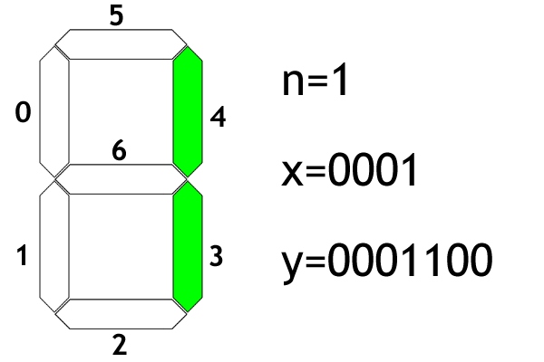
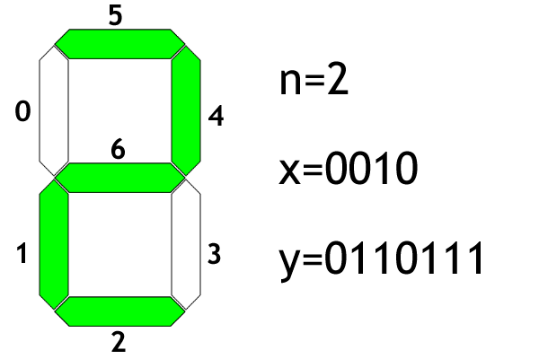
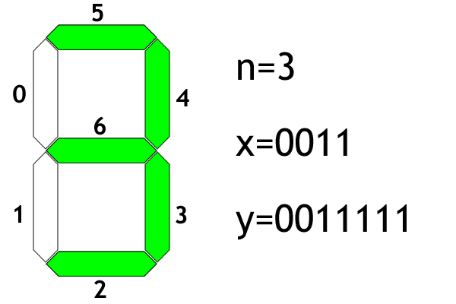
7-segment display logic synthesis

Slide 3
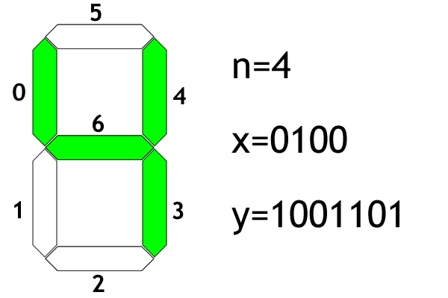
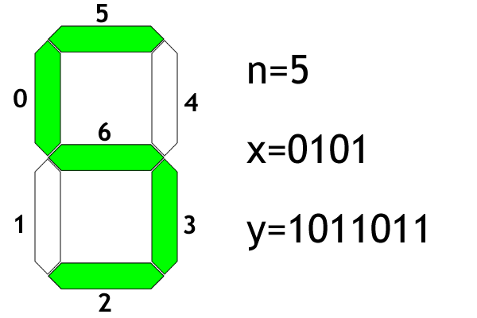
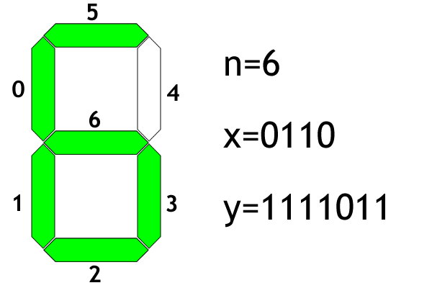
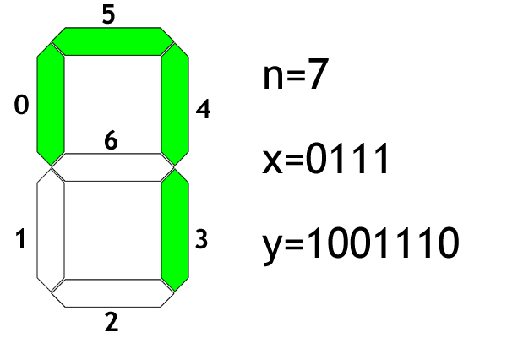
7-segment display logic synthesis

Slide 4
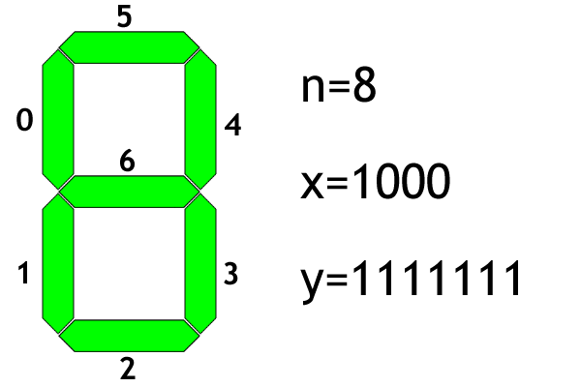
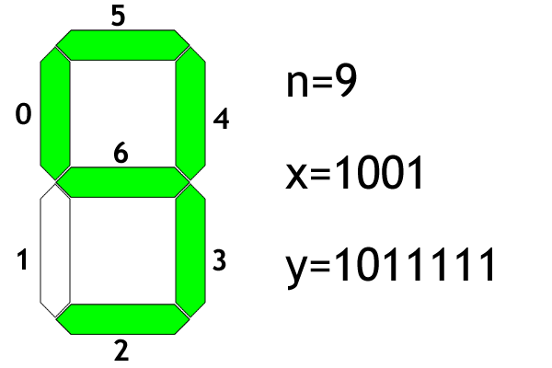
7-segment display logic synthesis

Slide 5
7-segment display logic synthesis
n | x₃ | x₂ | x₁ | x₀ | y₀ | y₁ | y₂ | y₃ | y₄ | y₅ | y₆
0 | 0 | 0 | 0 | 0 | 1 | 1 | 1 | 1 | 1 | 1 | 0
1 | 0 | 0 | 0 | 1 | 0 | 0 | 0 | 1 | 1 | 0 | 0
2 | 0 | 0 | 1 | 0 | 0 | 1 | 1 | 0 | 1 | 1 | 1
3 | 0 | 0 | 1 | 1 | 0 | 0 | 1 | 1 | 1 | 1 | 1
4 | 0 | 1 | 0 | 0 | 1 | 0 | 0 | 1 | 1 | 0 | 1
5 | 0 | 1 | 0 | 1 | 1 | 0 | 1 | 1 | 0 | 1 | 1
6 | 0 | 1 | 1 | 0 | 1 | 1 | 1 | 1 | 0 | 1 | 1
7 | 0 | 1 | 1 | 1 | 1 | 0 | 0 | 1 | 1 | 1 | 0
8 | 1 | 0 | 0 | 0 | 1 | 1 | 1 | 1 | 1 | 1 | 1
9 | 1 | 0 | 0 | 1 | 1 | 0 | 1 | 1 | 1 | 1 | 1

Slide 6

7-segment display logic synthesis
y₀
x₂x₁ x₄x₃ | 00 | 01 | 11 | 10
00 | 1
01 | 1 | 1 | 1 | 1
11 | - | - | - | -
10 | 1 | 1 | - | -

